Slide 1

Tiếp theo Chương 2 - phần 2.5_4

Slide 2

SkyNet is an open source instant messaging platform for Internet of Things
The SkyNet API supports both HTTP REST and real time WebSockets.
SkyNet allows users to register devices on the network
A device can be anything including sensors, smart home devices, cloud resources, drones etc.
Each device is assigned a UUID and a secret token.
Devices or client applications can subscribe to other devices and
receive/send messages
2

Slide 3
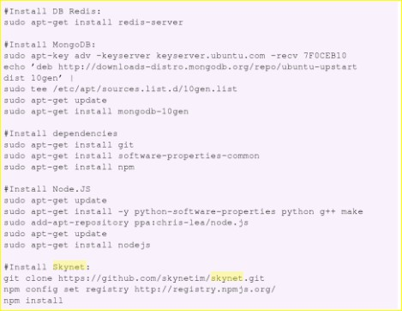
Commands to set up SkyNet IoT on Linux machine
3

Slide 4
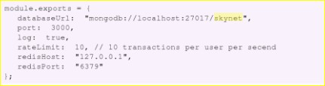

Sample SkyNet Configuration File:
4

Slide 5

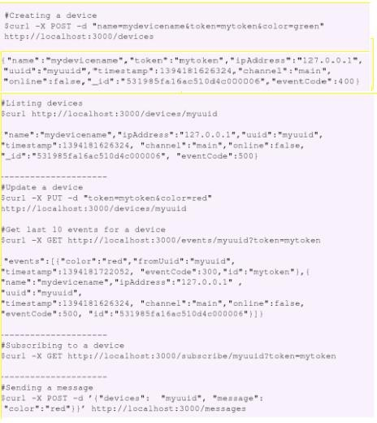
:: Using SkyNet REST API
5

Slide 6

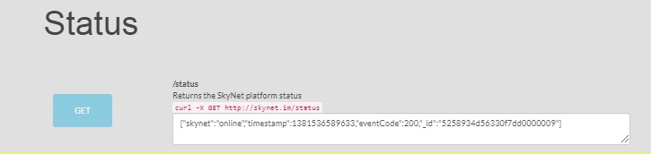
:: Using SkyNet REST API (Example – for Demo purpose only)

Slide 7
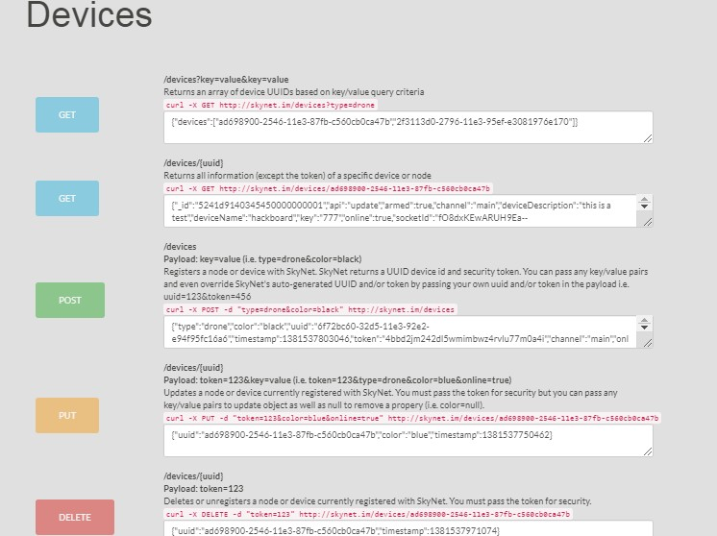
:: Using SkyNet REST API (Example – for Demo purpose only)

Slide 8
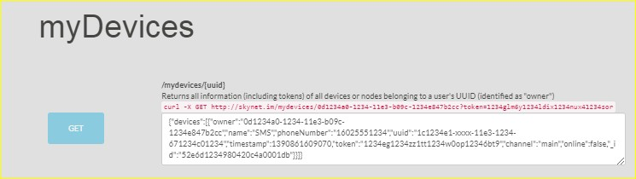
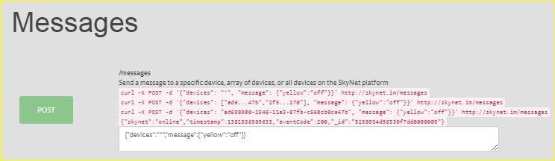
:: Using SkyNet REST API (Example – for Demo purpose only)

Slide 9
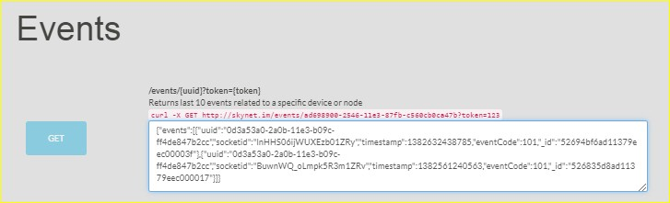
:: Using SkyNet REST API (Example – for Demo purpose only)

Slide 10
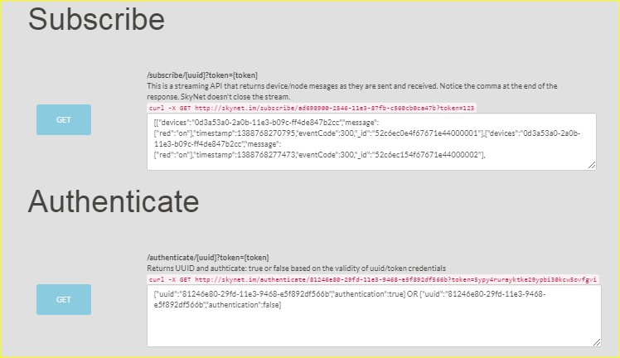
:: Using SkyNet REST API (Example – for Demo purpose only)

Slide 11
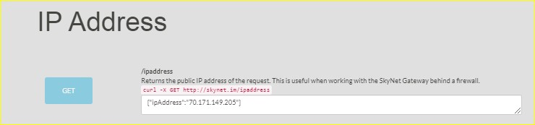
:: Using SkyNet REST API (Example – for Demo purpose only)

Slide 12
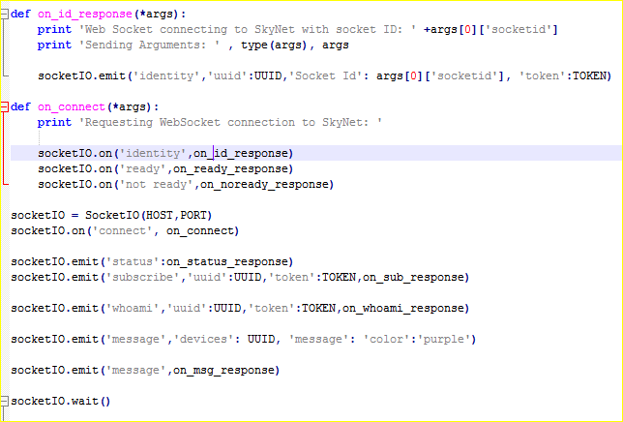
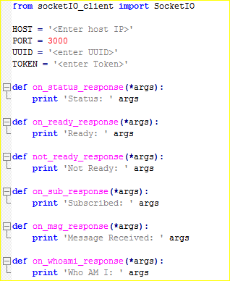

:: Python client for SkyNet
1
2

Slide 13

:: References
https://pypi.org/project/skynet/

Slide 14
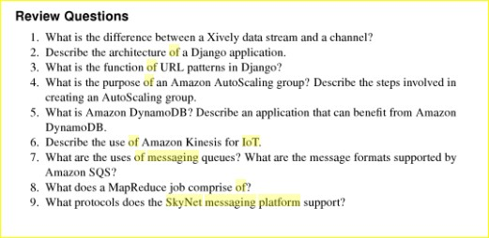

Slide 15


